Slide 1
Chapter 10 Thinking in Objects

Slide 2

Example: The StackOfIntegers Class
TestStackOfIntegers
Run

Slide 3
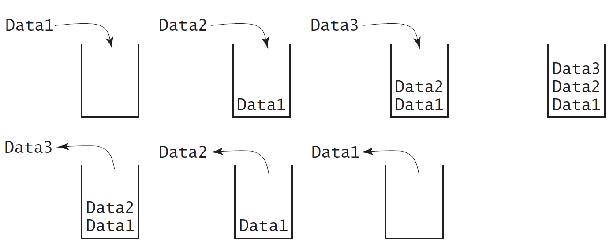
Designing the StackOfIntegers Class

Slide 4
StackOfIntegers.java
Pages 379-380 Listing 10.8

Slide 5
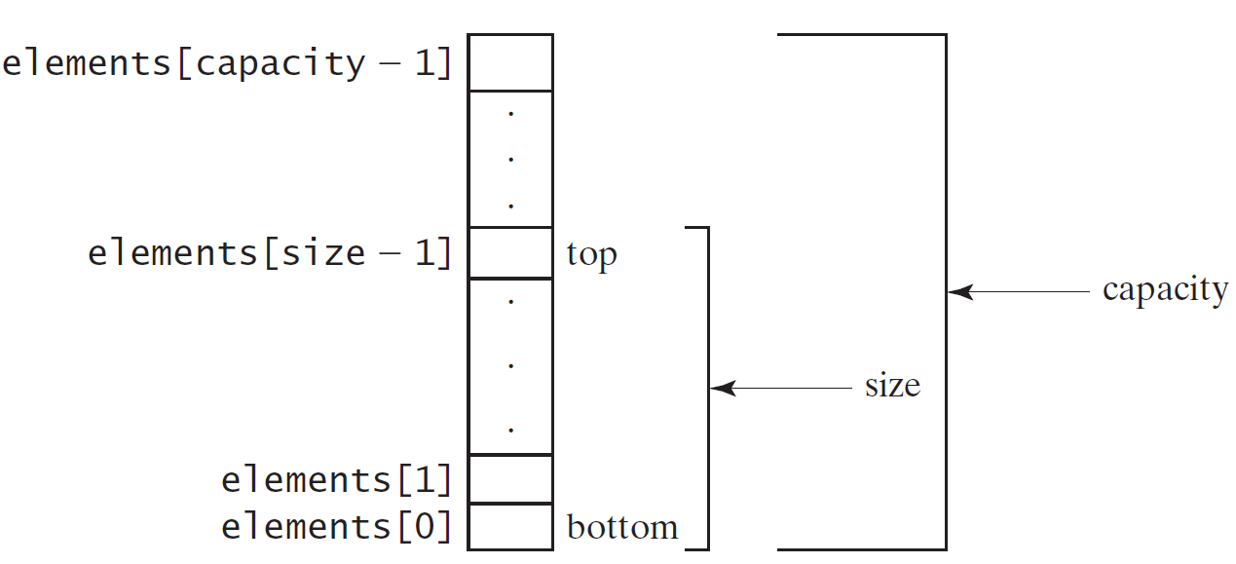
Implementing StackOfIntegers Class
StackOfIntegers

Slide 6
TestStackOfIntegers.java
Pages 378-9 Listing 10.7

